Slide 1
Microsoft Build Updates and Announcements
Nirmal Thewarathanthri
public string Title = “Cloud Solutions Architect”;
Jonathan Wade
public string Title = “Cloud Solutions Architect”;

Slide 2

Agenda
Build announcements & demos (all of them?)
Food when it arrives
Q & A

Slide 3
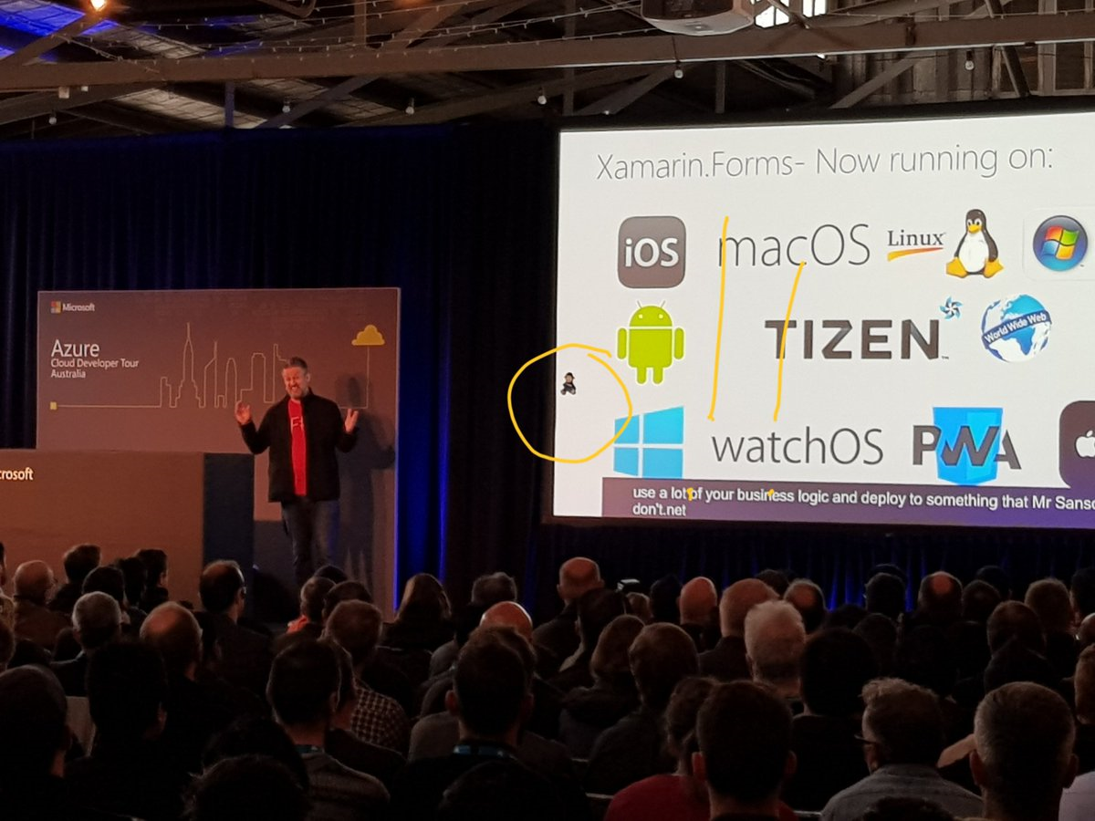

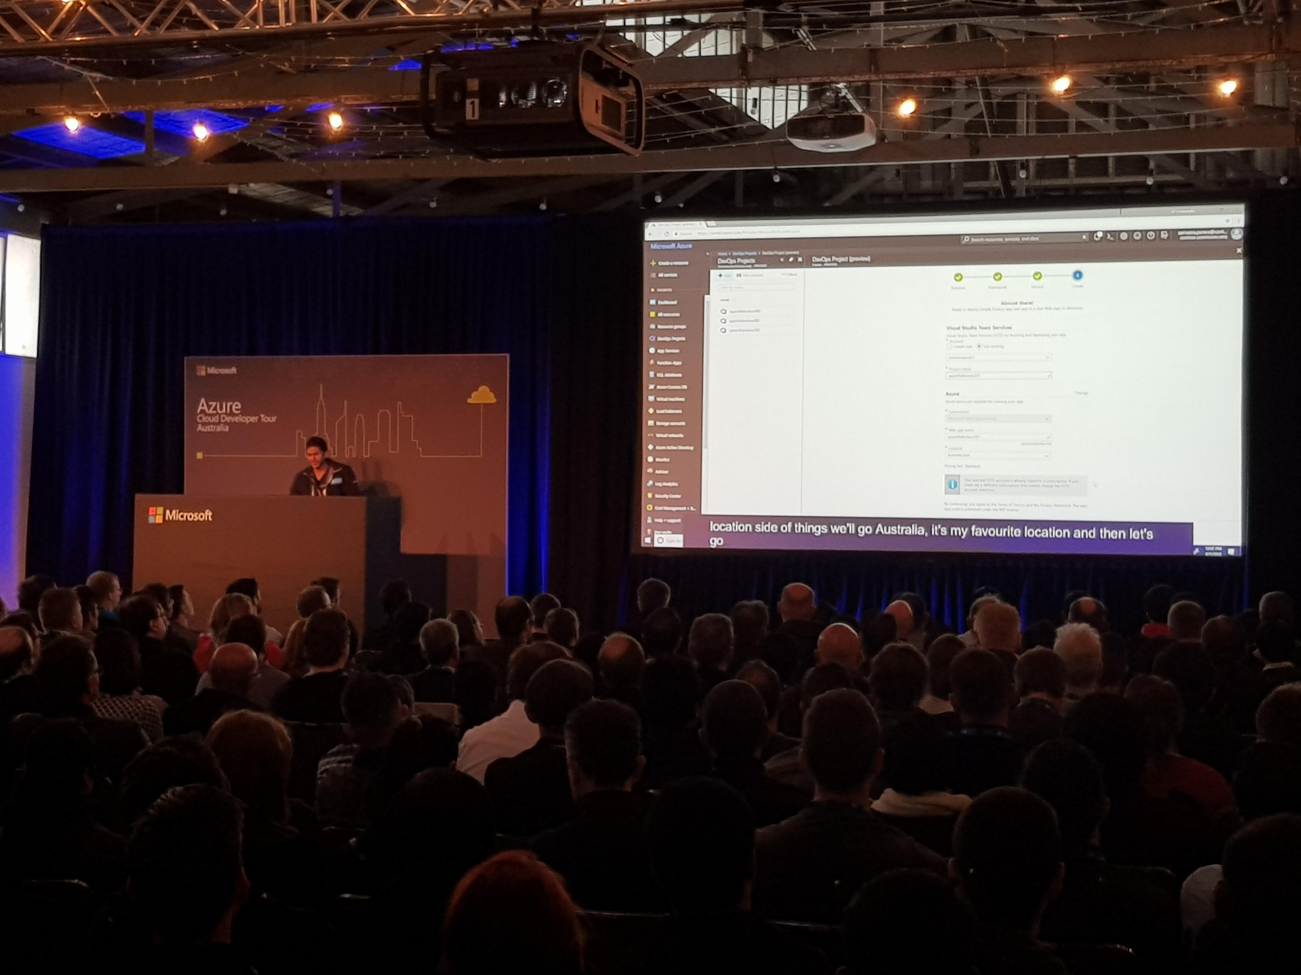
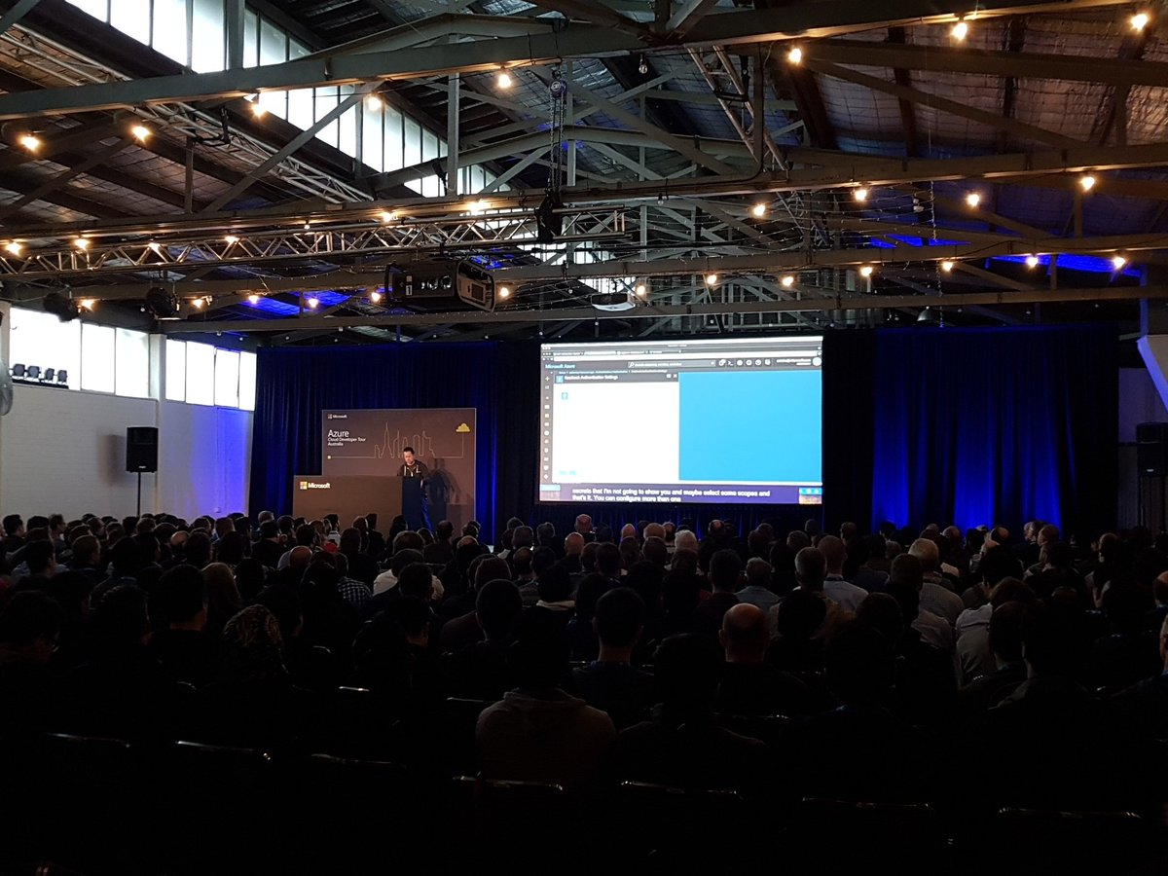
Azure Developer Tour!

Slide 4
Azure Announcements Since Jan
Compute
NCv3 / Ev3
Azure Batch – Rendering V-RAY
Serial Console
VM Scale Sets Enhancements
Networking
VNET Service Endpoints for Storage
Global VNET Peering
Azure DNS Private Zones
Azure DDOS Protection Service
Storage
Storage Service Encryption
Web & Mobile
Azure Mobile App
Containers
Azure Container Instances
Databases
Redis Cache – Geo Replication
SQL DB – Zone Redundancy
Azure SQL Database Managed Instance
Azure Hybrid Benefit for SQL Server
SQL DB Information Protection
Long Term Backup retention
read-scale out support
Azure Cosmos DB Data Explorer
Storage Explorer
Analytics
Databricks
IOT
Azure IOT Hub Basic
Azure IOT Remote Monitoring
Azure Maps
Security + Identity
Security Center
Azure AD B2C
Azure AD App Proxy
Developer Tools
OSS DevOps Ansible
OSS DevOps Jenkins
Management Tools
Azure Migrate
Azure Availability Zones
Azure Service Health

Slide 5
Build Announcements
Cloud Infrastructure + Management
Azure IoT Edge | Announcing new capabilities to Azure IoT Edge
Azure IoT Remote Monitoring | Update
ACI (Azure Container Instances) | ACI GA
Azure security and operations management | Azure Monitor container health Public Preview
Azure mobile app | Azure Mobile App GA
Azure CDN Standard Microsoft Tier | Public Preview
Windows Server | Windows Server, version 1803 GA
Azure Migration | GA
Business Applications + Application Platform
Azure "Event Grid" | Cloud Events Standard – Public Preview
Azure Functions | Durable Functions – GA
Azure SignalR Service | Azure SignalR Service Public Preview
Azure Blockchain Workbench | Public Preview
Azure App Service | App Service Windows Server Container support
Azure App Service | Multi-container with Web App for Containers Preview
Azure Media Services | Azure Media Services v3 API – Public Preview
Azure App Service | Public Preview – ASE for App Service on Linux
Azure App Service | Public Preview – Live debug, diagnostics, EasyAuth

Slide 6
Build Announcements
Data + AI
Azure Cosmos DB | Bulk library in .NET and Java – GA
Azure Cosmos DB | Multi-master – Public Preview
Azure Cosmos DB | Provision Throughput for a Set of Containers – Public Preview
Azure Cosmos DB | Virtual Network Service Endpoint – Public Preview
Azure Search | Cognitive Search – Public Preview
Azure SQL Database | TDE with Azure Key Vault – GA
Azure Maps (name change from Azure Location Based Services at //BUILD) | GA (Developer Offer)
Azure SQL Database | .Net/ODBC and SSDT – Public Preview
Cognitive Services | Cognitive Services Announcements
Azure SQL Data Warehouse | SQL DW Compute Optimized Gen2 GA
Azure Database Migration Service | Database Migration Service – GA
Developer Tools + Services
Visual Studio 2017 | Visual Studio 2017 – Update 15.7
Visual Studio Live Share | Public Preview of VS Live Share
Visual Studio Team Services | Azure DevOps Projects (Preview 2)
Visual Studio Team Services | RM Release Gates (GA)
Visual Studio for Mac | Update (version 7.5)
Visual Studio App Center | GA: App Center and GitHub Integration
.NET Core | Disclosure – .NET Core 3.0
.NET Core | .NET Core 2.1 RC
Xamarin.Forms 3.0 | Xamarin.Forms 3.0 GA
Azure Lab Services | Public Preview
Team Foundation Server 2018 | Update 2 (GA)
Developer Tools + Services
Azure AD Developer Experience | Azure AD Managed Service Identity GA

Slide 7
Announcements Since Build!
Azure SQL Data Warehouse now supports the automatic creation of column-level statistics.
General availability of Azure Security Center’s Cross Subscription Workspace Selection.
HTTP/2 support in Azure App Service and Azure Functions
General availability: Azure Database Migration Service
Azure Application Insights to monitor a distributed modern cloud application
Deeper analysis of this NSG flow data is available in Network Watcher using Traffic Analytics
General availability of SQL Vulnerability Assessment for Azure SQL Database!
Log alerts for Application Insights—which enables users to proactively monitor and trigger alerts from a custom analytics query
Storage Explorer, we also added new features in the latest 1.1
As an Enterprise Agreement administrator, you can now see Azure reserved instances purchased in your enrollment by going to the Azure portal. Key upcoming changes to the PowerShell experience in Azure Cloud Shell, namely: Faster startup time PowerShell Core 6 as the default experience Running on a Linux container Persistent Tool Settings the public preview of the create subscription experience in the Azure portal
Azure AD Authentication for Azure Blobs and Queues
Azure Database for MySQL now supports Data-in Replication
New offerings include the general availability of the Azure GDPR Data Subject Request (DSR) portal, Azure Policy, Compliance Manager for GDPR, Data Log Export, and the Azure Security and Compliance Blueprint for GDPR.

Slide 8
Announcements Since Build!
SAP HANA infrastructure in Azure with SUSE technology
Virtual network service endpoints for Azure Database for MySQL
Public preview of virtual network service endpoints for Azure Database for PostgreSQL
Soft delete for Azure Storage blobs has entered general availability
Azure File Sync service in Azure Storage - Refresh 2
Azure Standard SSDs are a cost-effective Managed Disk solution optimized for dev-test and entry-level production applications requiring consistent latency
Public preview of Storage Explorer in the Azure portal.
Announcing updated M-series VM sizes offering memory up to 12 TB on a single VM, the largest memory for a single VM in the public cloud for in-memory workloads such as SAP HANA
We're announcing newer M-series VM sizes with memory as low as 192 GB, extending M-series VM range from 192 GB to 4 TB in RAM
Customers can easily run scripts on an Azure VM directly from the Azure portal without having to connect to the machine. You can run either PowerShell scripts or Bash scripts and you can even troubleshoot a machine that has lost connection to the network.
Azure backup capability beyond virtual machines and files to also include backup of a SQL instance running on a VM
Disaster recovery for Azure IaaS virtual machines general availability
Integration of VSCode explorer with Azure blob storage

Slide 9
Cloud Infrastructure + Management

Slide 10

Cloud Infrastructure + Management
DDoS
VNET Service Endpoints
Global VNET Peering
M Series
Console Access
Container Time! – I K8s

Slide 11

Defense in Depth for Virtual Networks
Azure
Deployments
VM
Firewall
NSG & UDR
NVA/WAF
LB/NAT
DDoS
Internet
Azure

Slide 12







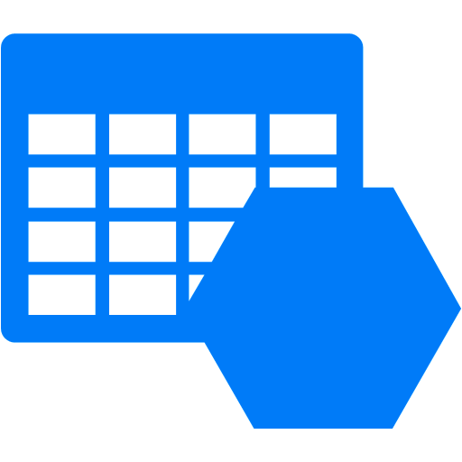



Virtual Network Security
Azure DDoS Protection
Internet
App GW/WAF
Web servers
Subnets enable network micro-segmentation design
Network Security Groups provide access control across subnets and Internet
Service Endpoints enable private IP access to PaaS services
Frontend Subnet
Internal load balancer
User-defined Routes
NVA Subnet
Application servers
App Subnet
Azure Storage
Internal load balancer
Download AccountA/Blob1
AccountA
Databases- VMs
Backend servers
SERVICE ENDPOINT
BE Subnet
Allow VNet A

Slide 13
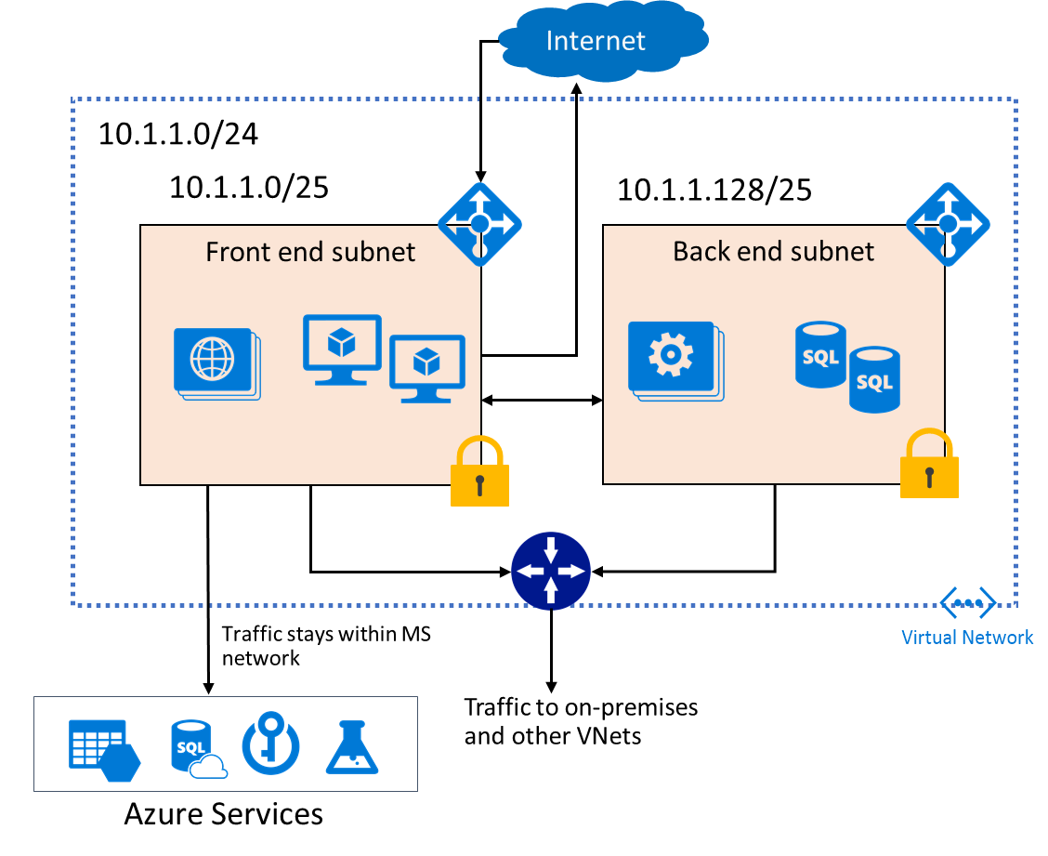
Virtual Network (VNet)
“Bring your own” network. Same controls as an on-premises network
Logical isolation of the public cloud, private network for the customer
Public or Private (RFC1918) address space
Address space only reachable within that VNet and connected networks

Slide 14








VNet – Azure Service Integration : Patterns
VNet Injection
VNet Service Endpoints
Dedicated service instances in VNets
Extend VNets to shared, multi-tenant services
Service RP
Internet/
Storage-SQL Access
Azure Shared Service
Service resources restricted to customer’s VNet
HDInsight
ASE
Redis
Virtual
Machine
Cloud Service
Virtual
Machine
On-premises
Single tenant Service:
Inbound/outbound access to VNets;
Access VNet/on-prem & vice-versa
Multi-Tenant Service:
knows about VNets and can filter access
Outbound only access from VNet
HDInsight, App Service, Batch etc.
Storage, SQL DB/DW, CosmosDB etc.

Slide 15


VNet Service Endpoints – How it works
Internet
Secure/Lock Service accounts to your VNet:Subnets.
Secure on-premises access through NAT IPs
Add NAT IPs using IP firewall for services
Deny Public internet access for Service
Service IPs and DNS entries remain as-is today
Azure LB
NSG
NSG
AccountA
(or SQL Server)
FrontEnd Subnet
(10.0.1.0/24)
BackEnd Subnet
(10.0.2.0/24)
Azure
Storage/ SQL
VIRTUAL NETWORK (VNET1)
(10.0.0.0/16)
VNet Service Endpoint
VPN GW
USWest
Allow VNET1:BESub
Allow On-Prem1: NATIP
Azure NW Backbone
ExpressRoute public Peering or the Internet
(over NAT IPs)
On_prem1

Slide 16
Cloud Infrastructure + Management
DDoS
VNET Service Endpoints
Global VNET Peering
M Series
Console Access
Container Time! – I K8s

Slide 17

Azure Kubernetes Service (AKS)
Azure Kubernetes Service (AKS)
A fully managed Kubernetes cluster
Azure Container Instances (ACI)
Managed control pane
Automated upgrades, patches
Easy cluster scaling
Self-healing
Cost savings
Azure Container Registry
Managed
Application architect
Applications
Open Service Broker API (OSBA)
Operations
Kubernetes
Infrastructure architect
Docker
Release Automation Tools
Azure infrastructure services

Slide 18
Data Services

Slide 19
Data Services
Azure Databricks
Cosmos Multi-Master
SQL – TDE with Azure Key Vault
SQL Migration Service (GA)

Slide 20

Azure Databricks
Azure Databricks is a first party service on Azure.
Unlike with other clouds, it is not an Azure Marketplace or a 3rd party hosted service.
Azure Databricks is integrated seamlessly with Azure services:
Azure Portal: Service an be launched directly from Azure Portal
Azure Storage Services: Directly access data in Azure Blob Storage and Azure Data Lake Store
Azure Active Directory: For user authentication, eliminating the need to maintain two separate sets of uses in Databricks and Azure.
Azure SQL DW and Azure Cosmos DB: Enables you to combine structured and unstructured data for analytics
Apache Kafka for HDInsight: Enables you to use Kafka as a streaming data source or sink
Azure Billing: You get a single bill from Azure
Azure Power BI: For rich data visualization
Microsoft Azure
Notes:
Azure Databricks is an Apache Spark-based analytics platform

Slide 21



Azure Databricks
Azure Databricks
Collaborative Workspace
IoT / streaming data
Machine learning models
DATA ENGINEER
DATA SCIENTIST
BUSINESS ANALYST
Deploy Production Jobs & Workflows
Cloud storage
BI tools
MULTI-STAGE PIPELINES
JOB SCHEDULER
NOTIFICATION & LOGS
Data warehouses
Optimized Databricks Runtime Engine
Data exports
Hadoop storage
DATABRICKS I/O
APACHE SPARK
SERVERLESS
Rest APIs
Data warehouses
Enhance Productivity
Build on secure & trusted cloud
Scale without limits

Slide 22



Azure Cosmos DB
A globally distributed, massively scalable, multi-model database service
SQL
MongoDB
Table API
Column-family
Document
Key-value
Graph
Guaranteed low latency at the 99th percentile
Elastic scale out
of storage & throughput
Five well-defined consistency models
Turnkey global distribution
Comprehensive SLAs

Slide 23
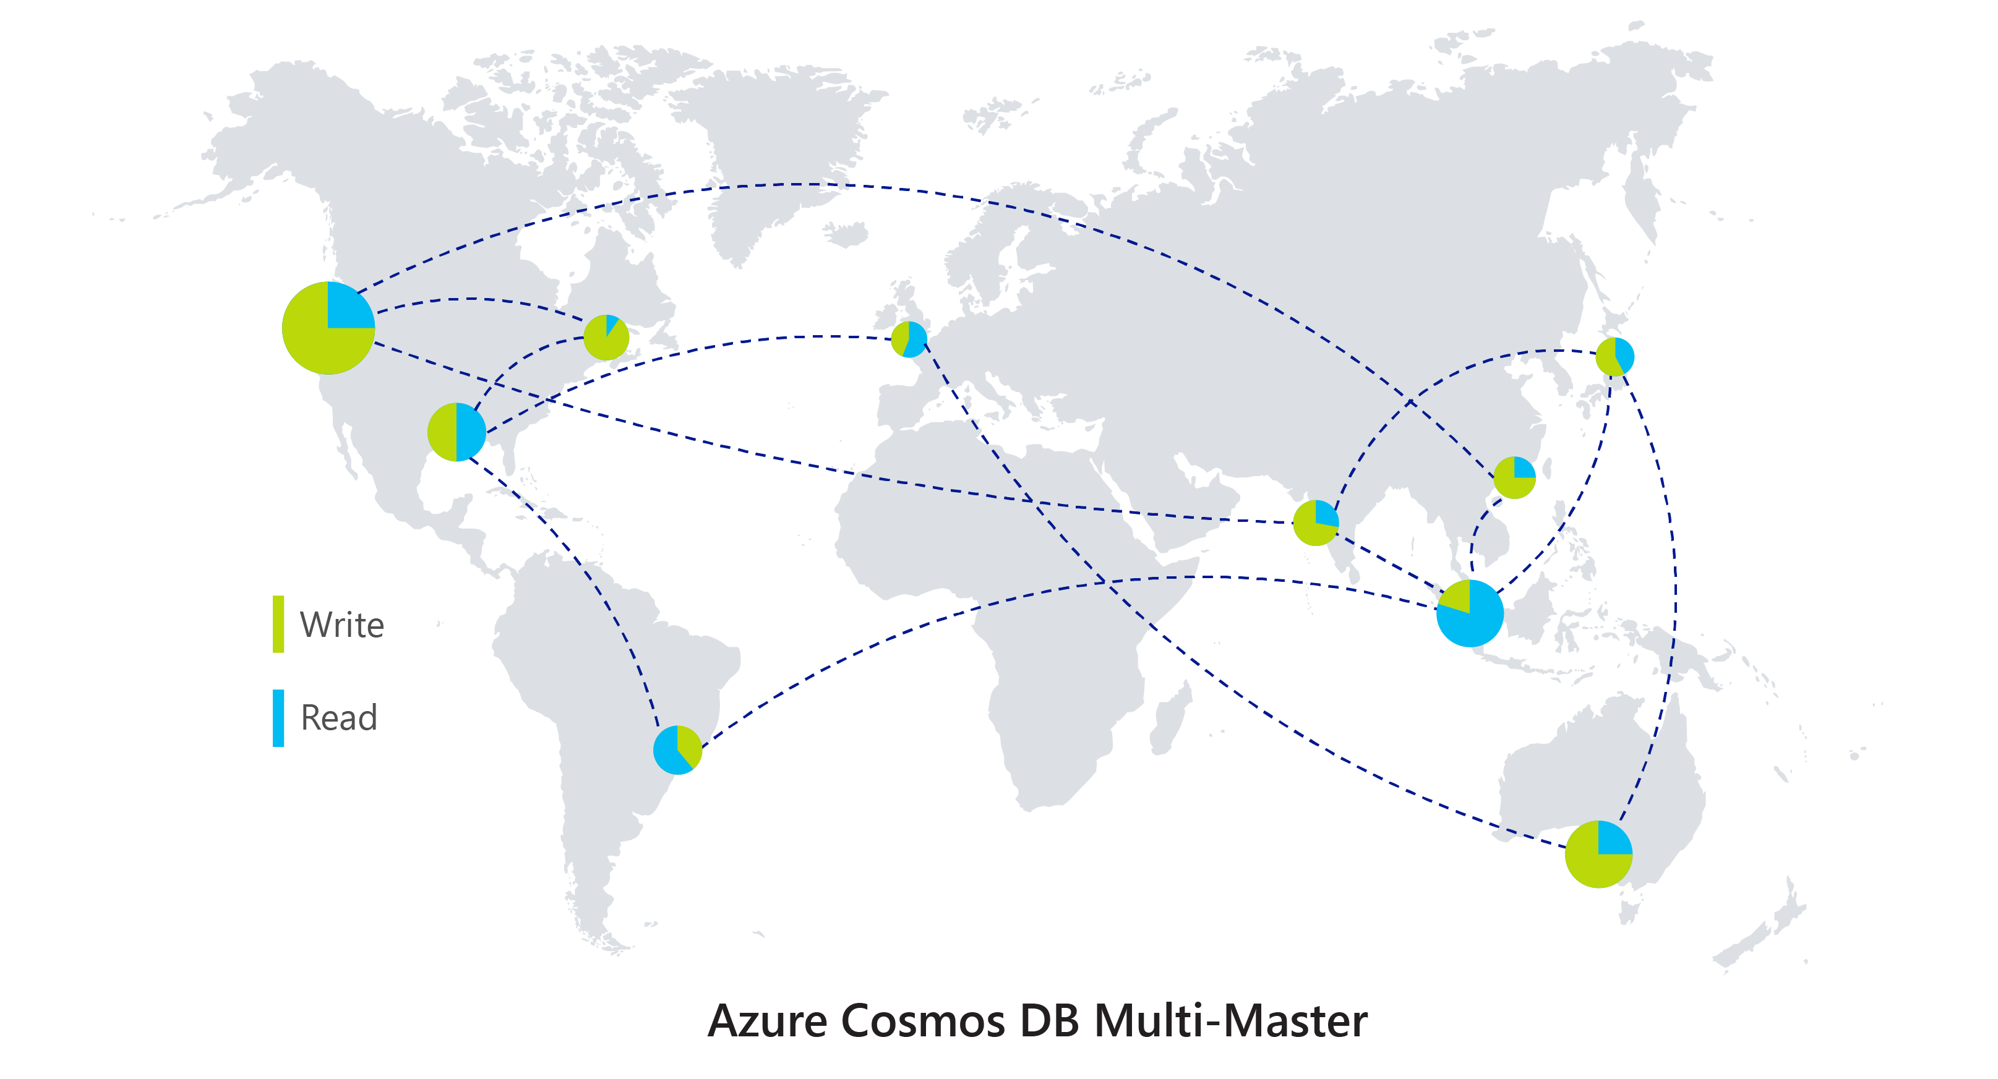
*New* Multi-Master (Preview)
Perfect for Intelligent Cloud
and Intelligent Edge Applications
Write scalability around the world
Low latency writes around the world
99.999% High Availability around the world
Well-defined consistency models
Comprehensive conflict management

Slide 24
Azure Database Migration Service
A seamless, end-to-end solution for moving on-premises SQL server, Oracle, and other relational databases to the cloud
Homogeneous
Resilient migration
Azure Database Migration Service (Azure DMS)
Heterogeneous
Scale migration
Orchestration

Slide 25



Azure Database Migration Service (DMS)
On-prem network
Cloud network
SQL
My
SQL Server
2005 - 2017
My
Internet
VPN or Express Route
Azure DMS
SQL
SQL
Assessment tools
SSMA & DMA

Slide 26
Apps & Developer Tools
Durable Functions
Visual Studio Live Share
Visual Studio Release Gates
Azure Lab Services

Slide 27








Azure Serverless application platform
Development
Platform
IDE support
Event Grid
Logic Apps
Functions
Manage all events that can trigger code or logic
Design workflows and orchestrate processes
Execute your code based on events you specify
Integrated DevOps
Local Development
Monitoring
Database
Storage
Security
IoT
Analytics
Intelligence
Visual Debug History

Slide 28
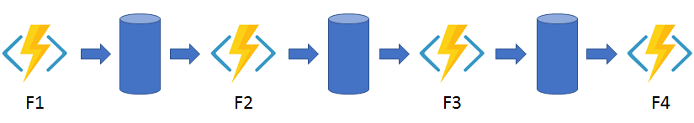
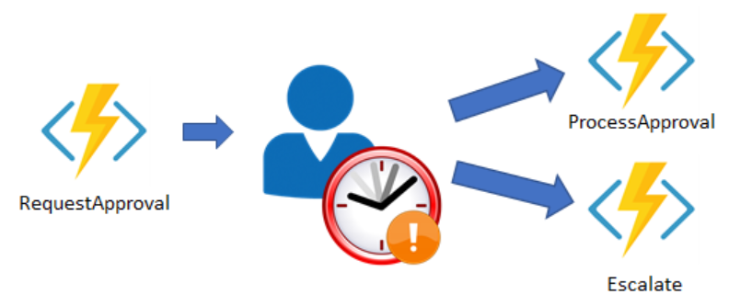
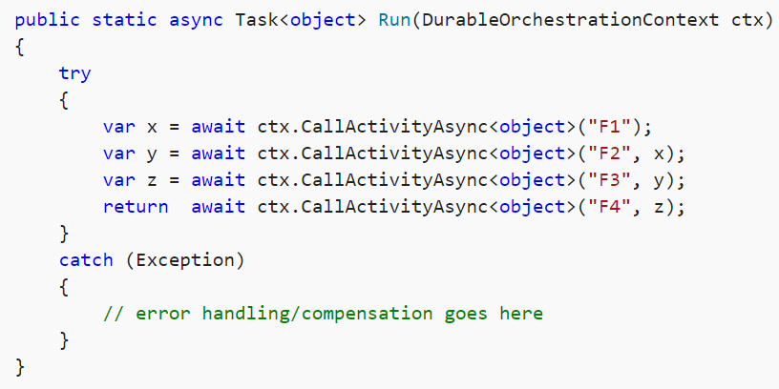
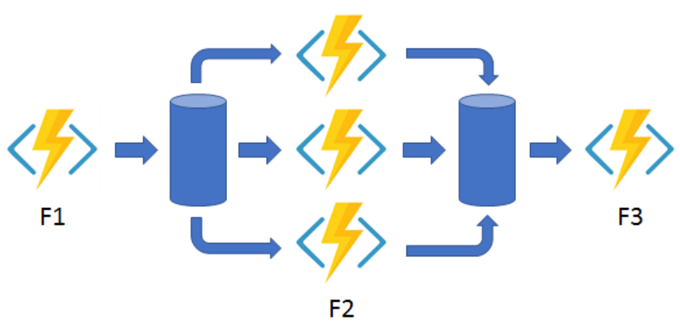
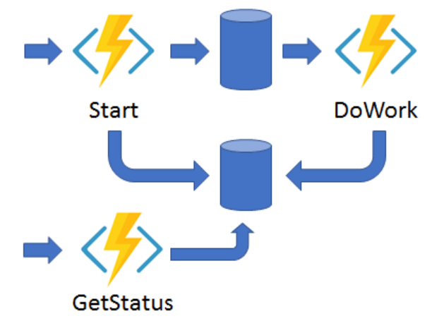
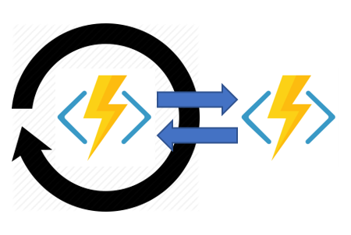
Solving practical problems
Function Chaining
Long running transaction
Fan Out / Fan In
Monitoring
Async HTTP APIs
Notes:
state, checkpoints, and restarts

Slide 29
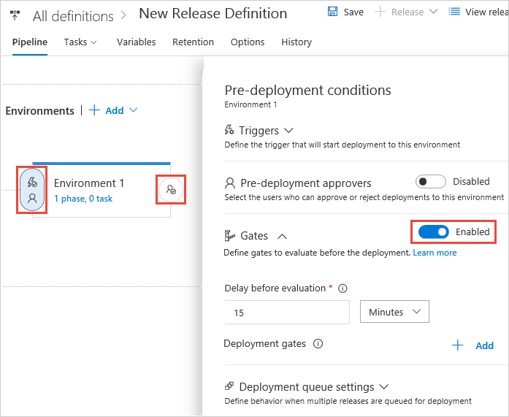
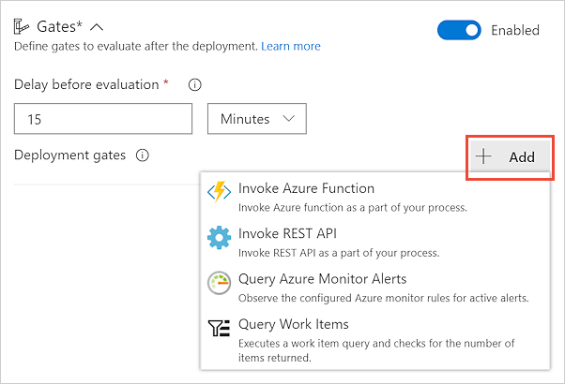
VSTS Release Gates
Incident and Issues management
Seek approvals outside of VSTS
Quality validation
Security scan on artifacts
User experience relative to baseline
Change Management
Infrastructure Health
Notes:
https://docs.microsoft.com/en-us/vsts/pipelines/release/approvals/gates?view=vsts

Slide 30
Demo VSTS – Release Gates

Slide 31
Demo Visual Studio Live Share

Slide 32

Azure Lab Services
…
Classroom Lab
Trial Lab
Custom Lab
(formerly DTL)

Slide 33
Fit for purpose labs
Test
Scenarios
Workstation
Scenarios
Scaled
Test
PaaS
Test
Env.
VMs Test
Env.
DevBox
Student
Box
Hackathon
Research
Box
On line
Training
Event
HOLs
Trial
Classroom
Demo
Education
Scenarios
Events
Scenarios
Notes:
For you to quickly get started with DevTest environments in Azure, we have solution called DevTest Labs. It’s an out-of-the-box solution that won’t get in any other cloud – it empowers your developers and gives the cost control and governance that your IT wants. DevTest Labs is good for multiple scenarios, including hosting your developer machines, test environments, and beyond Dev/Test scenarios, it’s also good for training/education scenario and trial/hackathon/demo scenario as well.

Slide 34
Demo Azure Lab Services

Slide 35
Cognitive Services

Slide 36
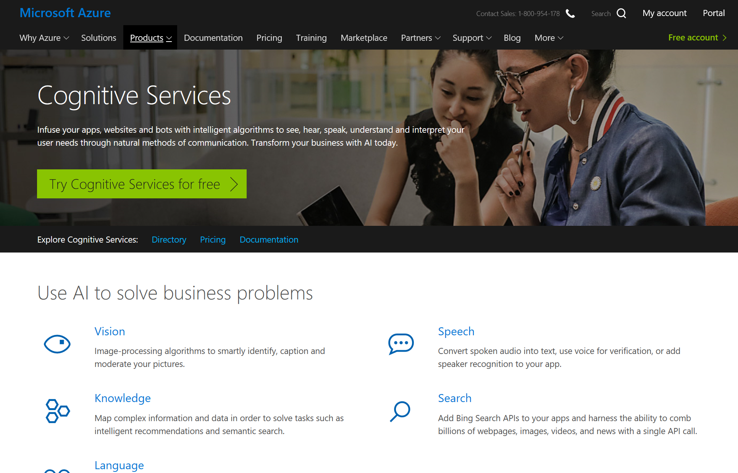
Notes:
https://azure.microsoft.com/en-au/services/cognitive-services/computer-vision/#handwriting

Slide 37
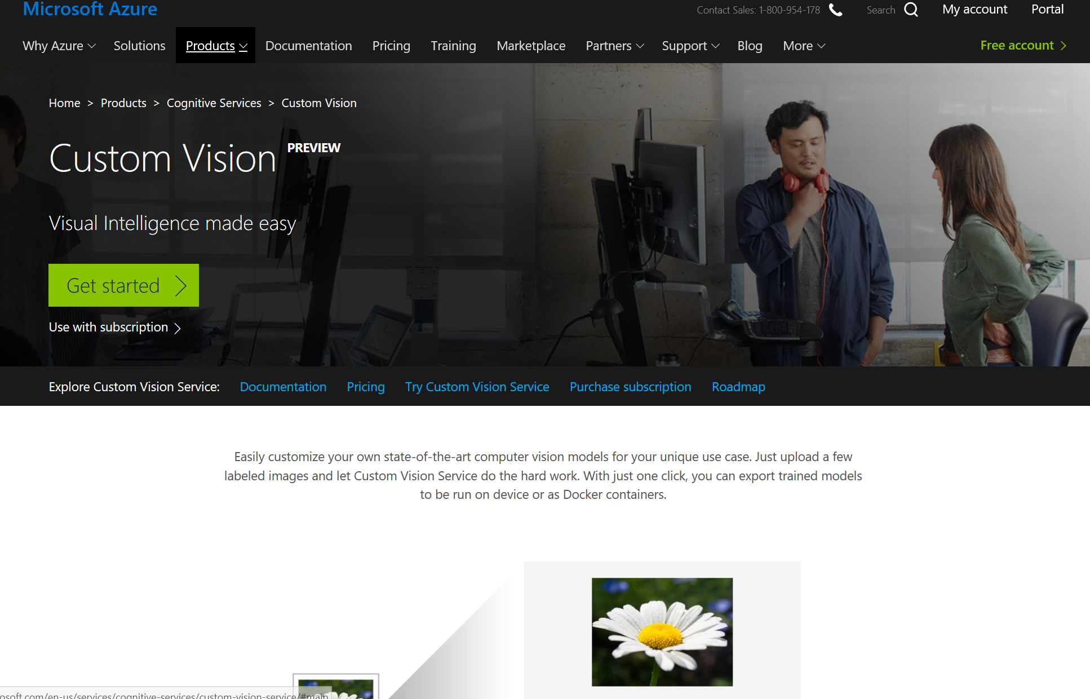

Slide 38
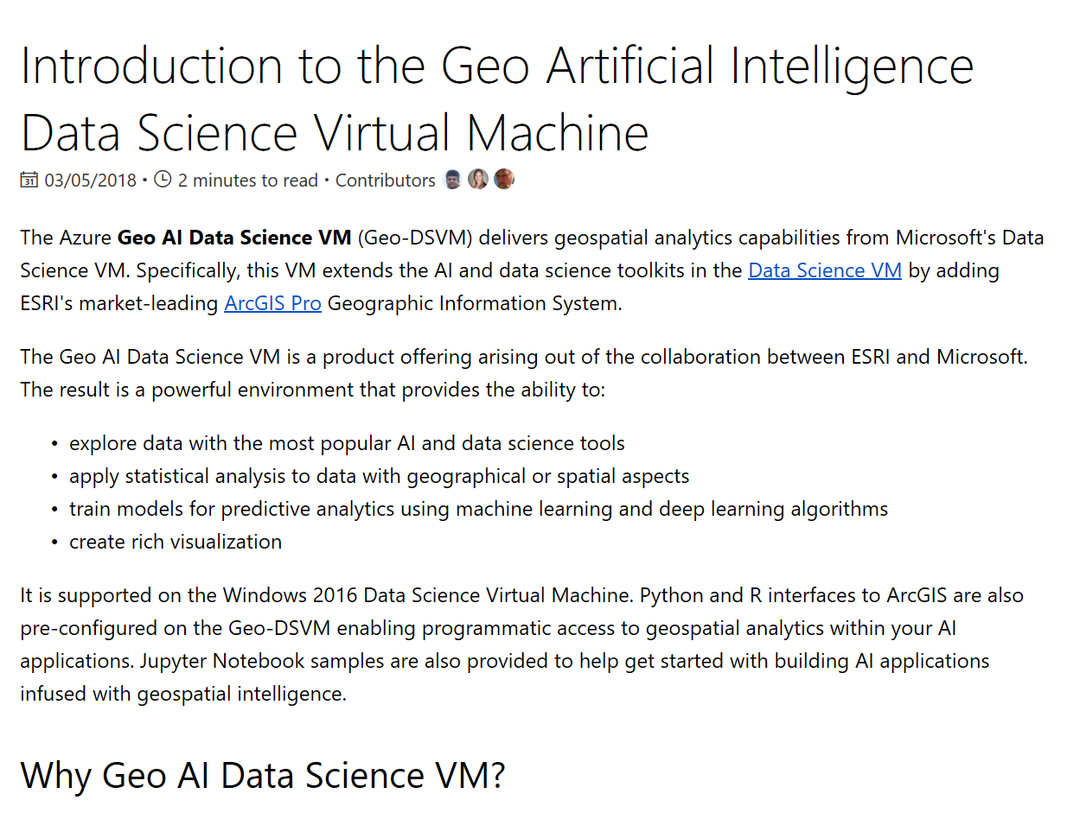
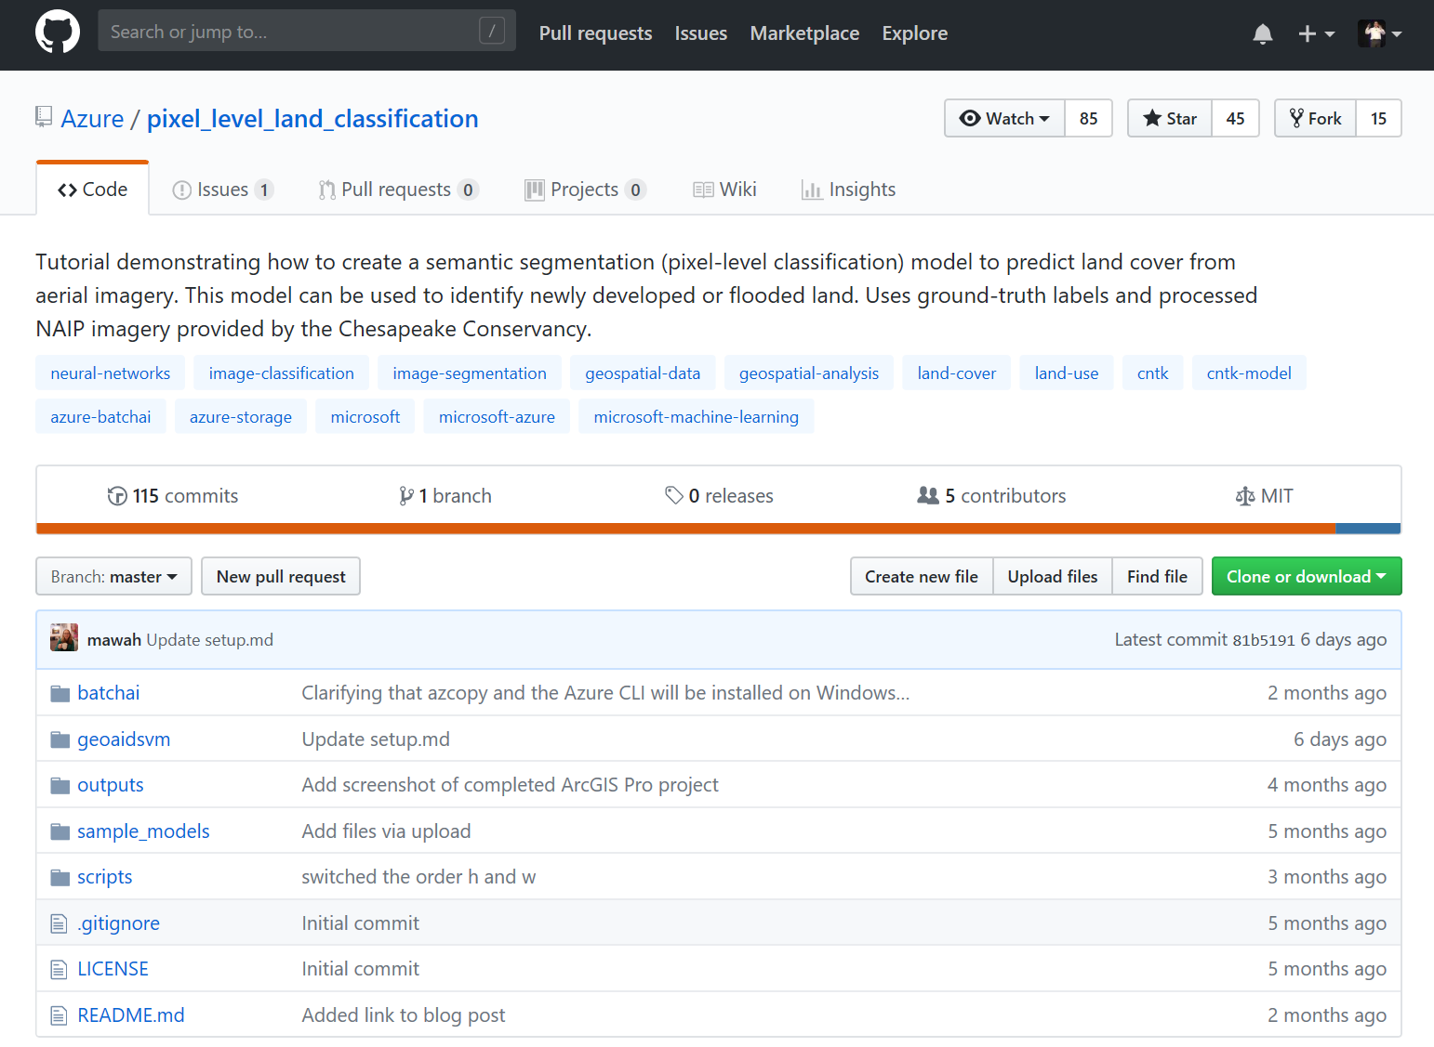
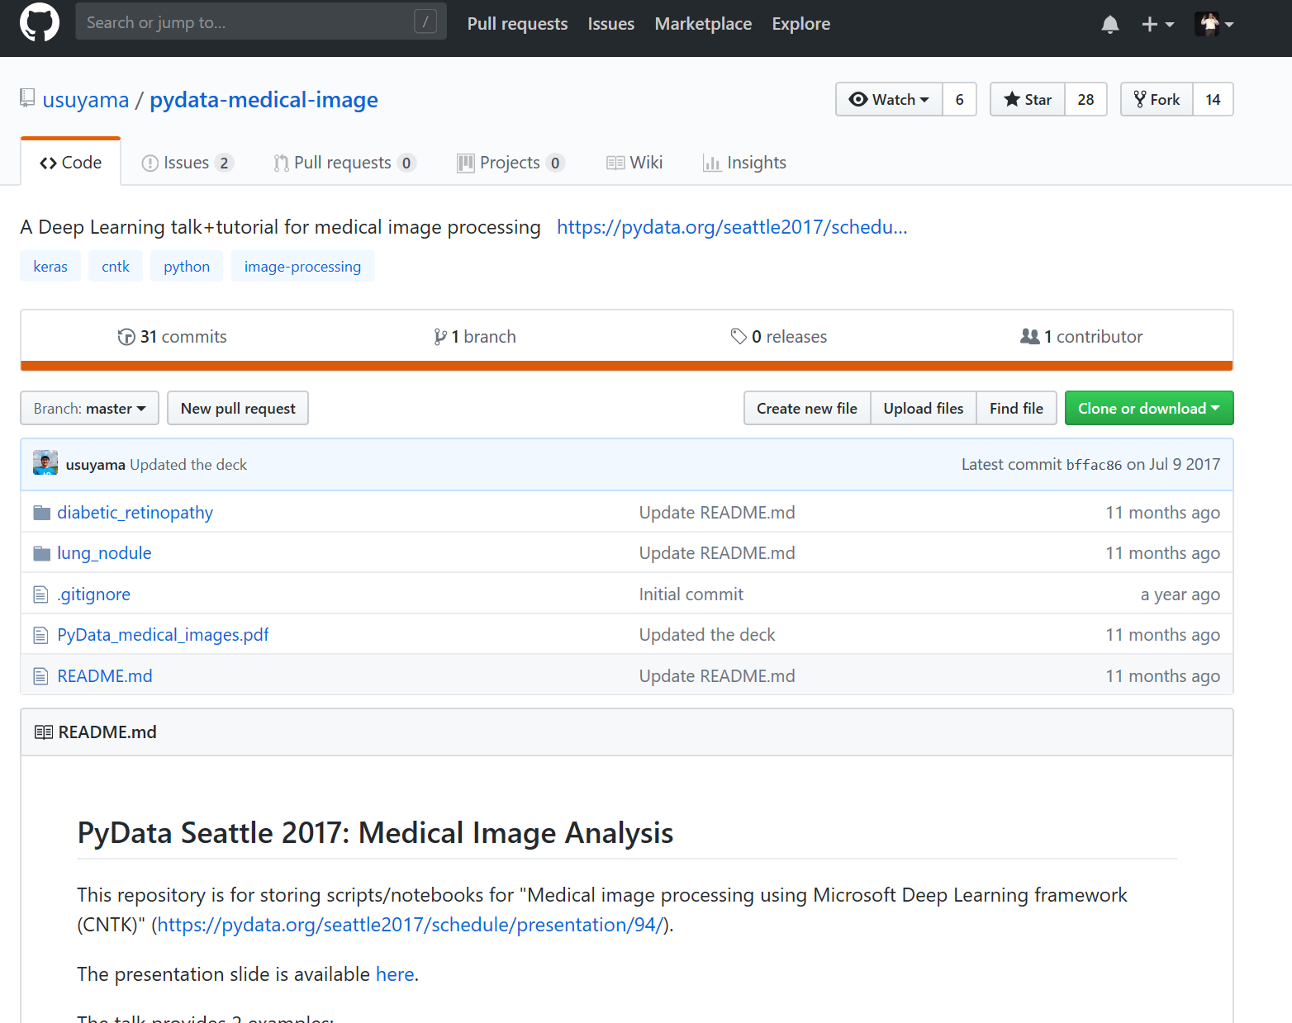

Slide 39
Resources
Slide Decks - Aka.ms/perthcsa
Build 2018 Sessions - https://channel9.msdn.com/Events/Build/2018

